Slide 1
Feasibility assessment and recruitment using routine data sources: experience from the THRIVE trial
Chris Bray & Rejive Dayanandan
CTSU, University of Oxford

Slide 2
The THRIVE trial (2007 – 2012)
A randomised trial of the long term clinical effects of raising HDL cholesterol with extended release niacin/laropiprant
Inclusion criteria
  Age >50
  Prior history of vascular disease
25,000 participants randomized in 6 countries between April 2007 – July 2010, of whom 8000 were at 88 sites in the UK

Slide 3
“The study design is “streamlined”: extra work for collaborating doctors and hospitals has been kept to a minimum …”
THRIVE recruitment strategy (UK): Coordinating Centre used EHR to identify and invite patients on behalf of local investigators.
Initial data request to confirm feasibility
    Did not require patient identifiable records
Follow-up request to proceed with invitations
    Did require patient identifiable records

Slide 4
Initial request to confirm feasibility

Slide 5
Feasibility: Requesting initial data
No local approvals required
PI identifies appropriate data analyst
Coordinating centre supplies data analyst with the data specification which details:
  What codes (ICD/READ/OPCS) to search for
  How far back to search
  Age limits for eligibility
  Data format (usually left to the analyst)
  Medium for supply data
Offer payment to cover costs

Slide 6
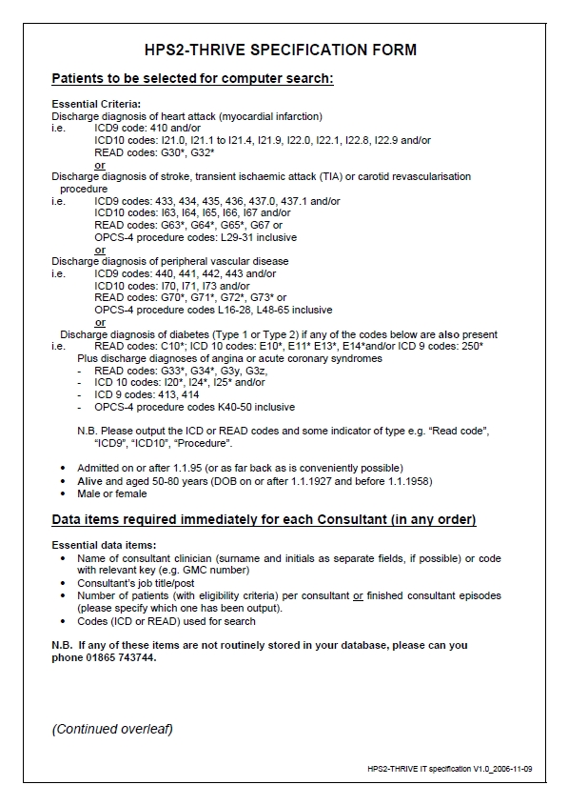
Feasibility: What is requested

Slide 7
Feasibility: Example of analyst output
Consultant | GMC Code | Count | Main Specialty
Dr. J. Hart | C3318137 | 3813 | Cardiology
Prof. G. Johnson | C8420855 | 3006 | Cardiology
Dr. L. Baines | C9766959 | 2390 | Cardiology
Dr. S. Gerrard | C4052208 | 2173 | Gastroenterology
Dr. G. Cahill | C1557035 | 1701 | General Medicine
Prof. P. Jagielka | C1365699 | 1548 | Cardiology
Dr. J. Wilshere | C2811103 | 1336 | Gastroenterology
Dr. F. Lampard | C8372529 | 1327 | General Medicine
Dr. D. Sturridge | C5778239 | 1254 | Cardiology
Dr. W. Rooney | C8816843 | 1200 | General Medicine
Prof. D. Welbeck | C2120044 | 1176 | General Medicine
Dr. C. Smalling | C5520180 | 1145 | Cardiology
Prof. J. Henderson | C4620701 | 1013 | Gastroenterology

Slide 8
Initial request to confirm feasibility
Assessment includes
Analyst response time & comms
Data quantity
Data quality
Review by local investigator

Slide 9
Feasibility: Turnaround time for initial data request
  Fastest 15 days
  Slowest 17 months
  Average 100 days

Slide 10
Proceeding to invitations

Slide 11
Invitation: Data requested
Essential data items:
  Patient name (surname, forename)
  Patient address (preferably including postcode)
  Sex
  Date of birth
  Name of consultant clinician (or code with relevant key)
  National code number of patient’s general practitioner (or name and address if code not available)
Desirable data items:
  Patient’s title
  NHS number
  Date of hospital admission
  Vital status at discharge (alive/dead)
  All discharge diagnoses (not just those on which the search was carried out)

Slide 12
Invitation: Data supply times
Time taken between sending request for full data and the data being marked as "OK" at the Coordinating Centre:
  Fastest 10 days
  Slowest 7.5 months
  Average 60 days

Slide 13
Pros & Cons*
Minimal site involvement | Reliance on Trust systems and analysts
Can run in parallel with site set-up | Higher ‘screen failure’ rate
Improved recruitment management: | Vulnerable to changes in data protection legislation
keep screening clinics busy | Potential to upset patients invited
reliable predictions | Declining response rate to letters
targeted recruitment options | Needs large pool of pts to invite
*vs leaving it to the local investigator and staff to identify and invite patients to attend screening visits

Slide 14
Invitation trends
 |  |  | THRIVE
Recruiting |  |  | 2007-2010
Invited |  |  | 230,000
Screened |  |  | 24,000
 |  |  | 10%
 | HPS | SEARCH
Recruiting | 1994-1997 | 1998-2001
Invited | 131,000 | 83,000
Screened | 64,000 | 35,000
 | 49% | 42%
 |  |  |  | REVEAL
 |  |  |  | 2011-2013
 |  |  |  | 330,000
 |  |  |  | 19,000
 |  |  |  | 6%

Slide 15
Summary
EHR were used (by the Coordinating Centre, on behalf of the local investigator) as part of the site feasibility assessment and subsequently to invite patients to attend screening visits
  Minimal input from site staff; so activities can start before they have been appointed and then continue in parallel
  Large numbers of patients can be invited
Challenges for this recruitment model include
  Decreasing response rate
  Public acceptance
  Legal/regulatory issues (Section 251; EU data protection regulation)

Slide 16
Acknowledgement
We would like to thank the administrators, data analysts and clerical staff at the THRIVE Coordinating Centre at CTSU, Oxford, who kept the 88 THRIVE sites in the UK topped-up with patients to screen until they reached the national target of 8000 randomized participants.

