Slide 1

Harnessing health data for patient and public benefit
Professor Tjeerd van Staa
HeRC (tjeerd.vanstaa@manchester.ac.uk)

Slide 2


Slide 3
van Staa TP, Dyson L, McCann G, Padmanabhan S, Belatri R, Goldacre B, Cassell J, Pirmohamed M, Torgerson D, Ronaldson S, Adamson J, Taweel A, Delaney B, Mahmood S, Baracaia S, Round T, Fox R, Hunter T, Gulliford M, Smeeth L. The opportunities and challenges of pragmatic point-of-care randomised trials using routinely collected electronic records: evaluations of two exemplar trials. Health Technol Assess 2014 Jul;18(43):1-146. doi: 10.3310/hta18430.

Slide 5
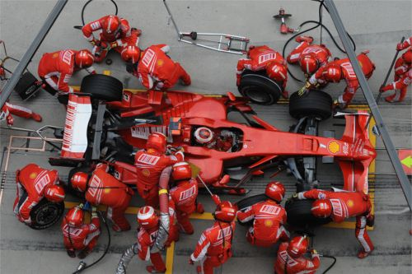
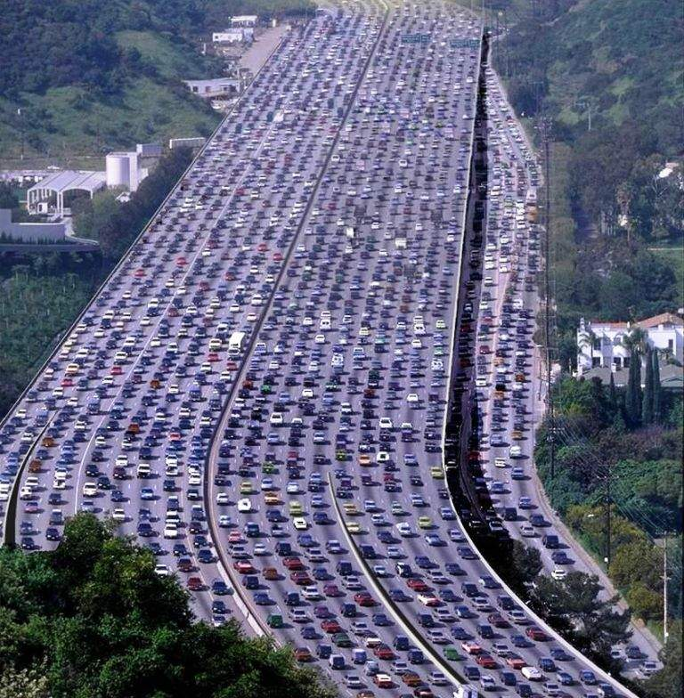


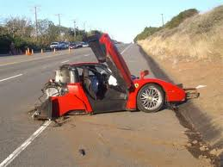

Phases of drug development
=>

Slide 6
Explanatory and pragmatic trials (Schwartz and Lellouch 1967)
Explanatory trials => to verify a biological hypothesis – study population well adapted to the problem at hand, homogeneous and low withdrawal rate
Pragmatic trials => to choose between two treatment. Usually complex interventions; no external validity beyond class of patients studied; trial should be representative of class of patients
Schwartz and Lellouch did not focus on the current beliefs that explanatory and pragmatic trials are different with respect to internal and external validity!

Slide 7
Exemplar trials
-RETRO-PRO: the effectiveness of simvastatin compared to atorvastatin—a feasibility study (ISRCTN33113202)
-’cold’ recruitment
-funded by Wellcome Trust
-eLUNG: the effectiveness of antibiotics compared to no antibiotics for exacerbations of chronic obstructive pulmonary disease: a feasibility study (ISRCTN72035428)
-’hot’ recruitment
-funded by the HTA NIHR
=> Primary objective: to test feasibility
Qualitative research on GP and patient perspectives

Slide 8
Electronic Health Records:
Clinical Practice Research Datalink
Central repository of anonymised EHRs
EHR records of General Practitioners across the UK = central healthcare provider; EHR for record keeping
About 5% of the population included
Pseudo-anonymised records (using opt-out system)
Linked to other datasets using NHS number (e.g. hospital data, death certificates, registries)
Regular transmission of data from practice to CPRD (monthly update of research database; daily for trial practices)
ResearchOne alternative to CPRD

Slide 9
Drop-out rates of practices at each step in the recruitment and approval procedure

Slide 10
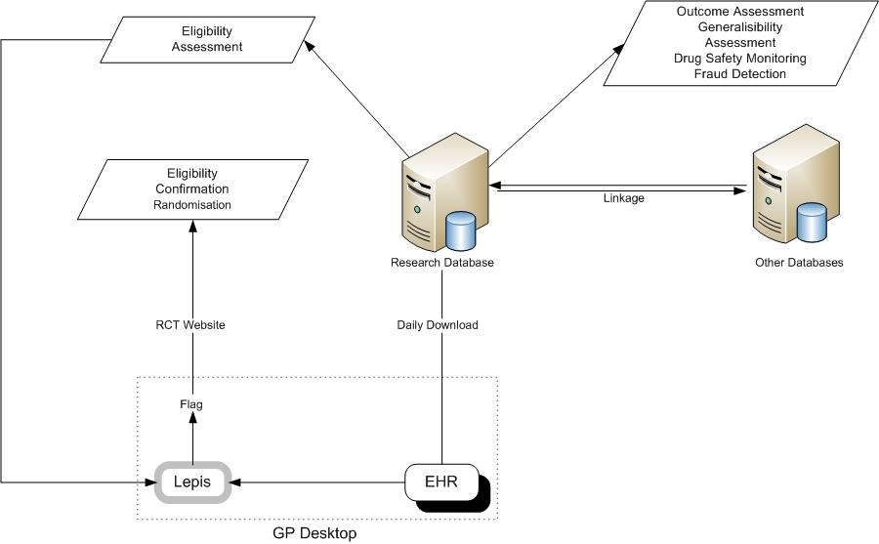
IT system in EHR trials

Slide 11
Pop-up boxes - flags for eLung and Retropro

Slide 12
Selection of eligible patients
Monthly research database: creation of list of eligible patients
    patients with >15% CVD risk according to Framingham or QRisk2 + no exclusions
    COPD patients + no exclusions
Daily processing: further exclusions
    Statin Rx => removal from list
    Antibiotic => removal for 2 weeks
GP confirms eligibility (on website): only patients on the list can be recruited!
First eligibility assessment done centrally => complex searches can be done

Slide 13
Recruitment of patients
Three different models:
    List of eligible patients: screening by GP => directly to study website + log-in + entry of patient number (Retropro)
    Data entry of specific Read code during consultation for patient on eligibility list => LEPIS activated => link to study website (Retropro)
    Start consultation for patient on eligibility list => LEPIS activated => link to study website (eLung/ Retropro)

Slide 14
Monitoring of LEPIS

Slide 15
Follow-up in trials
Major clinical outcomes
    Linked datasets
    GP to confirm: prospective, randomised, open, blinded endpoint evaluation (PROBE) design
    Blinded review by assessors
Persistence to treatment
Additional data may be collected
    QoL+FEV1 with eDiary in eLung
    Blood test for genetic analyses at month 3

Slide 16
Characteristics of Retropro and non-trial participants

Slide 17
Positive factors influencing the GP decision on participation in eLung
1. Consistency with local prescribing guidance (N=18)
2. Relevance of topic (N=14)
3. Feasibility to recruit (N=13)
- Number of patients (N=9)
- Minimal impact of rescue packs (N=4)
4. Computer-based pop up alerts (N=10)
5. Hot recruitment method (N=6)
6. Demands of study design on GP time (N=4)
7. Benefit to patients (N=3)

Slide 18
Negative factors influencing the GP decision on participation in eLung
1. Feasibility to recruit (N=10)
  High impact of rescue packs (N=4)
  Patient views on ‘no antibiotics’ (N=4)
  Number of patients (N=2)
  Lack of referrals from other GPs (N=1)
2. Hot recruitment method (N=9)
3. Relevance of topic (N=4)
4. Time to conduct study at point of invitation (N=4)
5. Demands of study design on GP time (N=4)
6. Computer-based pop up alerts (N=3)
7. Consistency with local prescribing guidance (N=2)

Slide 19
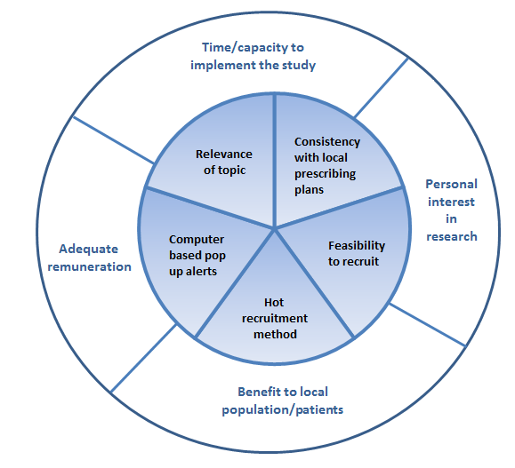
Most important factors influencing the GP decision to accept or decline
Outer circle: Generic factors for any research project Inner circle: Project-specific factors

Slide 20
Qualitative feedback of eLung participants
The main reason for agreeing to take part in eLung was the hope that it might improve their own health (6/10) or other people’s health in the future (4/10). Seven of the ten patients cited their excellent doctor-patient relationship as a key influencing factor in their decision-making process and their trust that it will be in their best interest to participate in the study if their GP has asked them
All 10 patients considered use of EHRs to collect trial outcome data to be acceptable. This included one patient who thought routine medical records would provide more useful information than patient reported information and one patient who preferred not to complete too many questionnaires due to suffering from arthritis. All patients preferred the data to be anonymised for use by a research team and one patient expressed their explicit support for longitudinal data analysis if the data would not be used for any other purpose

Slide 21

Medical records: please release them, let them go
With the voluntary releasing of medical records, people can play as active a role in healthcare as they do in politics
Absurdly, it's easier to choose arbitrary treatments for everyone, than to suggest one treatment for half the people who need it and another treatment for the other half
The only thing to change would be that an arbitrary decision about how to treat you would be based on a random allocation instead. It's cheap, easy, and a great way to see uncertainties over treatments resolved.

Slide 22
Cluster Randomised Trials and Electronic Patient Records

Slide 23
Data Quality of routinely collected data
– different views
Only prospectively collected data are valid: site visits / study-specific CRFs / central adjudication of outcomes
Gold-standard approach + validation
‘Pragmatic’ approach: mixture of statistical techniques, clinical review of potential cases and confirmation of known associations
Big Data: lots of data with application of statistical models
Simple outcomes!
Duration of follow-up / statistical power / costs also affect data quality
High quality of data recording may be reached when the conclusion is no different than if all of these elements had been recorded without error [innovative approaches to clinical trials IOM]

Slide 24

Discussion
EHR point-of-care trials are feasible but complexity of trial approvals
Randomisation to address uncertainty should be a matter of routine
Farr could be ideal place to further expand this method

