Slide 1
Identification of eligible patients for clinical research within primary care
(examples from Keele)
Presented by Dr Martyn Lewis

Slide 2
Problems encountered with GP’s recruiting to studies
Past problems with paper based recruitment
Restricted time length of consultation
More real time info collected
= more GP burden
= less patients recruited
Remembering the study
Study information not always to hand
Patients intentionally filtered out
Notes:
So before the days of auto-prompts GP’s recruited patients directly using a more paper based method, this brought with it a few problems or hurdles to recruiting
Past problems with paper based recruitment
Restricted time in the consultation making it impractical to undertake additional recruitment-specific tasks
When GPs did remember at the appropriate time the additional tasks involved add to the consultation time putting pressure on the GPs
Busy doctors not remembering the study during the consultation
Study information was not always to hand,
GPs sometimes intentionally filtered out patients for social reasons, or because of other morbidities, rather than the clinical inclusion or exclusion criteria specified in the trial eligibility criteria

Slide 3
“Within our network general practices we (the ARUK Primary Care Centre) work with the PCRN to add templates into the electronic systems which, on entry of an appropriate Read Code, can either pop-up a screen to alert the clinician to discuss the study with the potentially eligible individual or can put a flag in the patient’s record for the PCRN to download data at a later date.”
Notes:
In order to help overcome some of these barriers we considered automating the process. We had several aims:-
We wanted to set up an automatic system that would flag up appropriate patients to the GPs using the read code triggers that they were routinely recording.
We wanted to ensure that the appropriate information about the trial was immediately available to the GP so that they could discuss the trial with the patient in an informed manner and not have to search for relevant paper work
Vitally, we wanted to make the process more efficient so that it had less of an impact on the consultation time
And finally we wanted to remove the administrative burden from the GP completely be setting up the practice system in such a way that would allow us to automatically print off patient specific consent and referral forms that could be faxed directly to our centre

Slide 4
Overcoming the Problems
Automated screen prompt added to GP system
Activated when specific Read Code is entered
Use of Templates: on-screen forms to enable swift, consistent and easy data entry
Works by:
  Only appropriate patients are flagged
  Automated recording of consent to be contacted
  Recruitment has minimal impact on consultation time
  Removes admin burden from the GP
Notes:
In order to help overcome some of these barriers we considered automating the process. We had several aims:-
We wanted to set up an automatic system that would flag up appropriate patients to the GPs using the read code triggers that they were routinely recording.
We wanted to ensure that the appropriate information about the trial was immediately available to the GP so that they could discuss the trial with the patient in an informed manner and not have to search for relevant paper work
Vitally, we wanted to make the process more efficient so that it had less of an impact on the consultation time
And finally we wanted to remove the administrative burden from the GP completely be setting up the practice system in such a way that would allow us to automatically print off patient specific consent and referral forms that could be faxed directly to our centre

Slide 5
Patient recruitment for Low Back Pain Trial following introduction of auto-prompt system
Practice Groups A & B use manual method only
Practice Group A install auto-prompt
Notes:
5
READ TITLE FROM SLIDE
The final graphs shows you the IMPACT ……….. on PATIENT RECRUITMENT
For our low back pain trial there were two groups of practices A & B
Initially both sets of practices were using a manual paper-based method of recruitment
At the point shown by the dotted line
in GROUP A practices (represented by the RED column) we installed an auto-prompt system
And you can see the effect that this had on the recruitment rate for the following months
In the automated practices the recruitment rate significantly increased
As compared to those practices using the manual paper based system
Autoprompt summary
Automated processes are efficient and effective
Reduced GP involvement, and admin burden
Lead to a higher yield of patients
Timely follow up after GP consultation
Dedicated consent and “cooling-off” period provided
Accurate data for mailing

Slide 6

IMPaCTBACK Study
Participants: Aged 18+ consulting with non specific low back pain
GP Practice Before- & After- Trial
  Before- (Phase 1) – ‘Control’ phase
  Phase 2 – Training of GPs (in all participating Practices)
  After- (Phase 3) – ‘Intervention’ phase
Read code activated Protocol identifies eligible participants
GP screened patient to make sure they didn’t meet exclusion criteria
Phase 3: For eligible participants, 6-item screening tool template activated

Slide 7
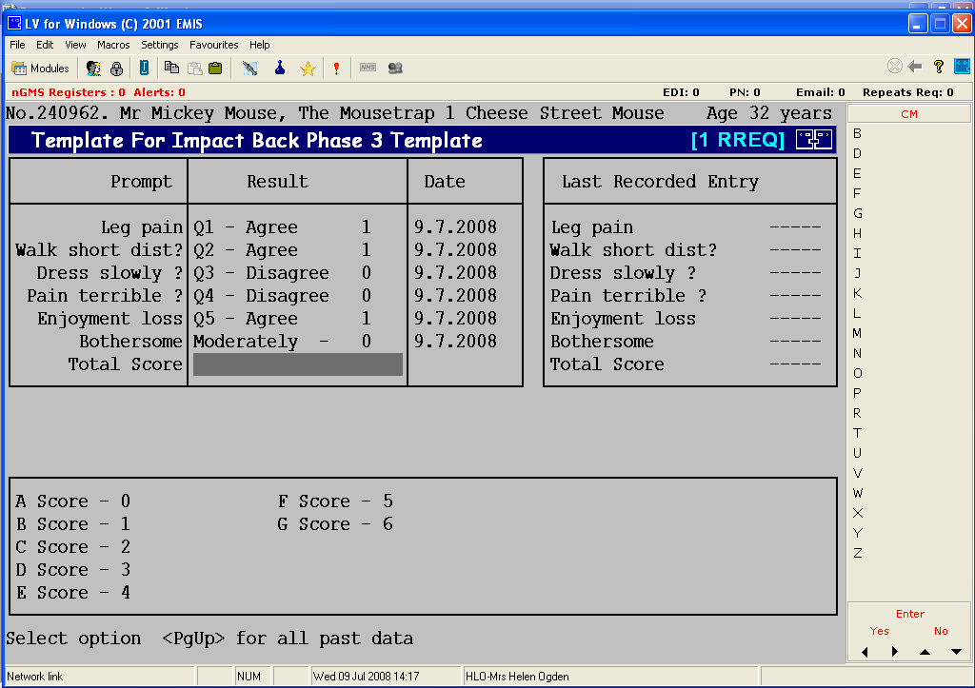
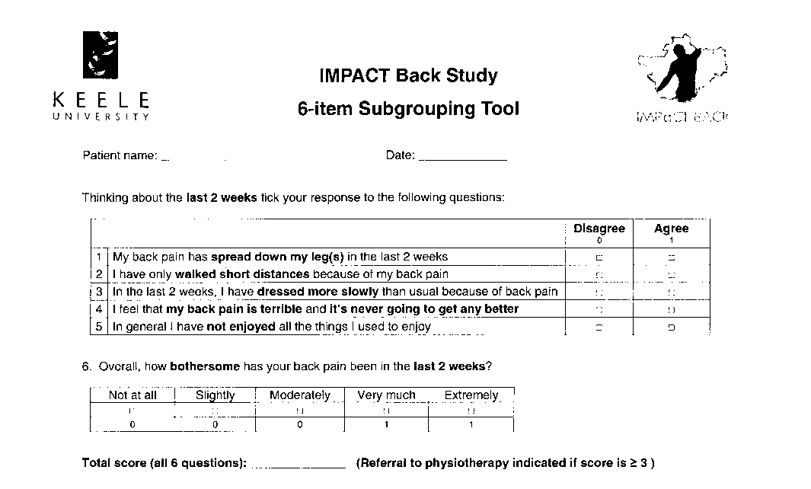
IMPaCTBACK Study
Incorporating STarTBACK 6 - Item Subgrouping Tool
Using the laminated question sheet, the GP is able to electronically record the patients responses to the 6 questions
By entering the patients score, the protocol is able to calculate and inform the GP of the recommended treatment option

Slide 8

SWAP – Study of Work and Pain
Cluster RCT evaluating the effect of introducing a vocational advisor to help patients with musculoskeletal pain return to work
Practices randomly allocated to:-
  intervention arm (patients see vocational advisor)
  control arm (current usual practice followed)

Slide 9
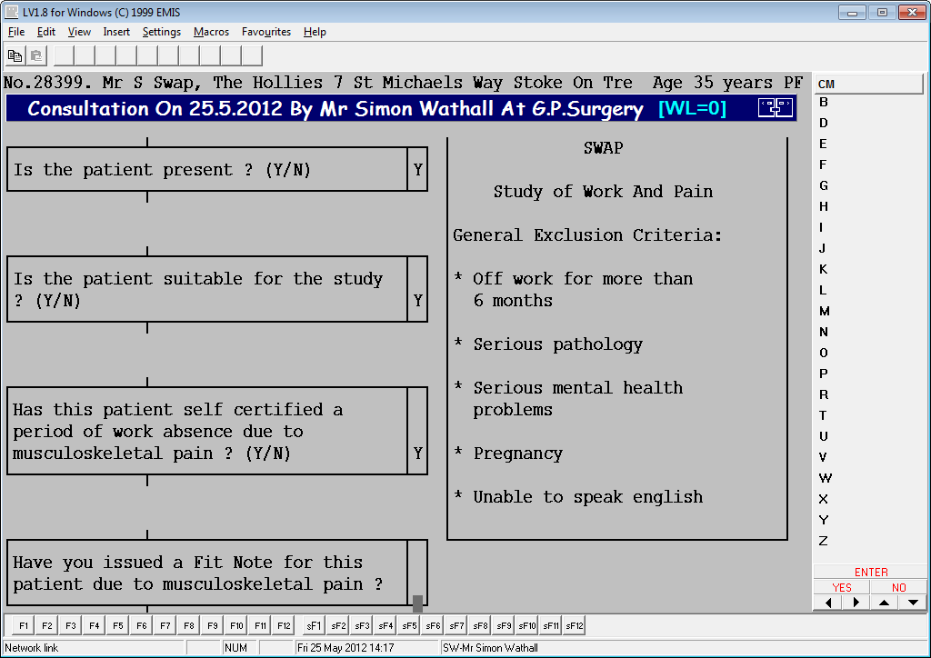
SWAP – Study of Work and Pain

Slide 10
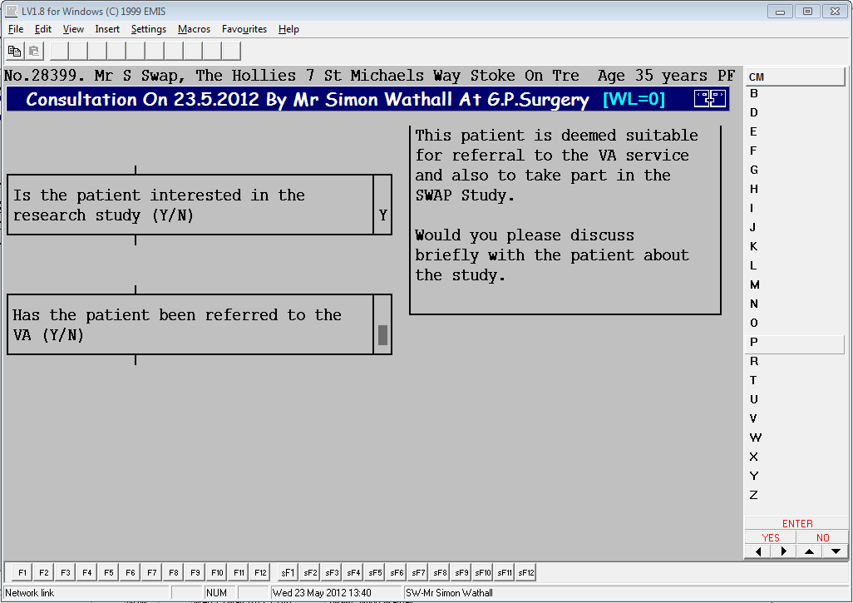
SWAP – Study of Work and Pain

Slide 11
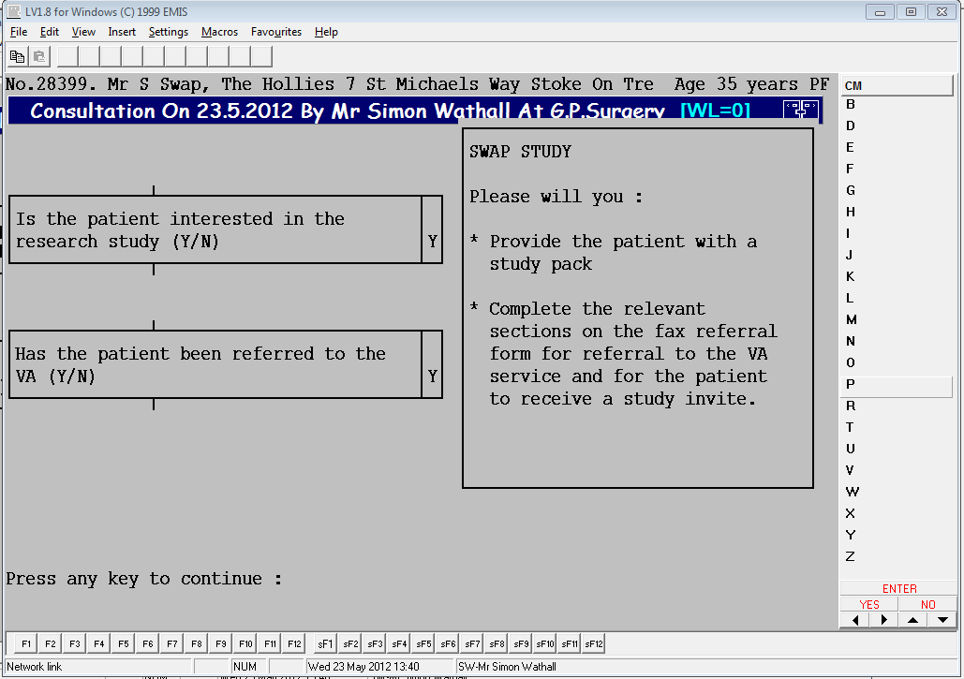
SWAP – Study of Work and Pain

Slide 12
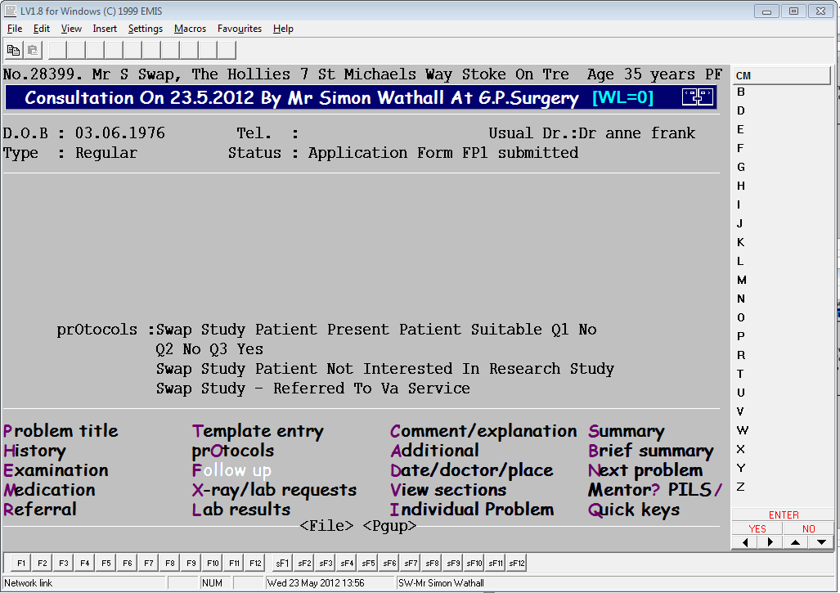
SWAP – Study of Work and Pain

Slide 13
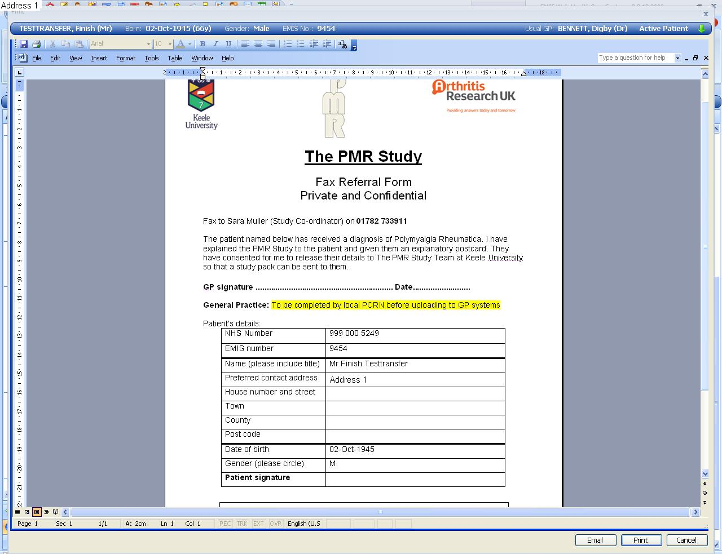
EMIS WEB
EMIS allows easier provision for study specific auto completed mail merged documents to be produced in the consultation to aid study recruitment / referral

Slide 14
In Summary - Automated recruitment methods
Offer efficient and effective real time data capture
Lead to a higher yield of patients if used correctly
Give increased precision in identifying patients
Good coverage – templates developed for EMIS (50% of GP Practices), System One (20%) & Vision (20%)
Provide a mechanism for recording of patient flowchart in respect of trial recruitment (data available on ineligibility / exclusions / ‘escapes’

Slide 15

Simon Wathall
NIHR CRN WM Health Informatics Specialist
Acknowledgements

